Slide 1
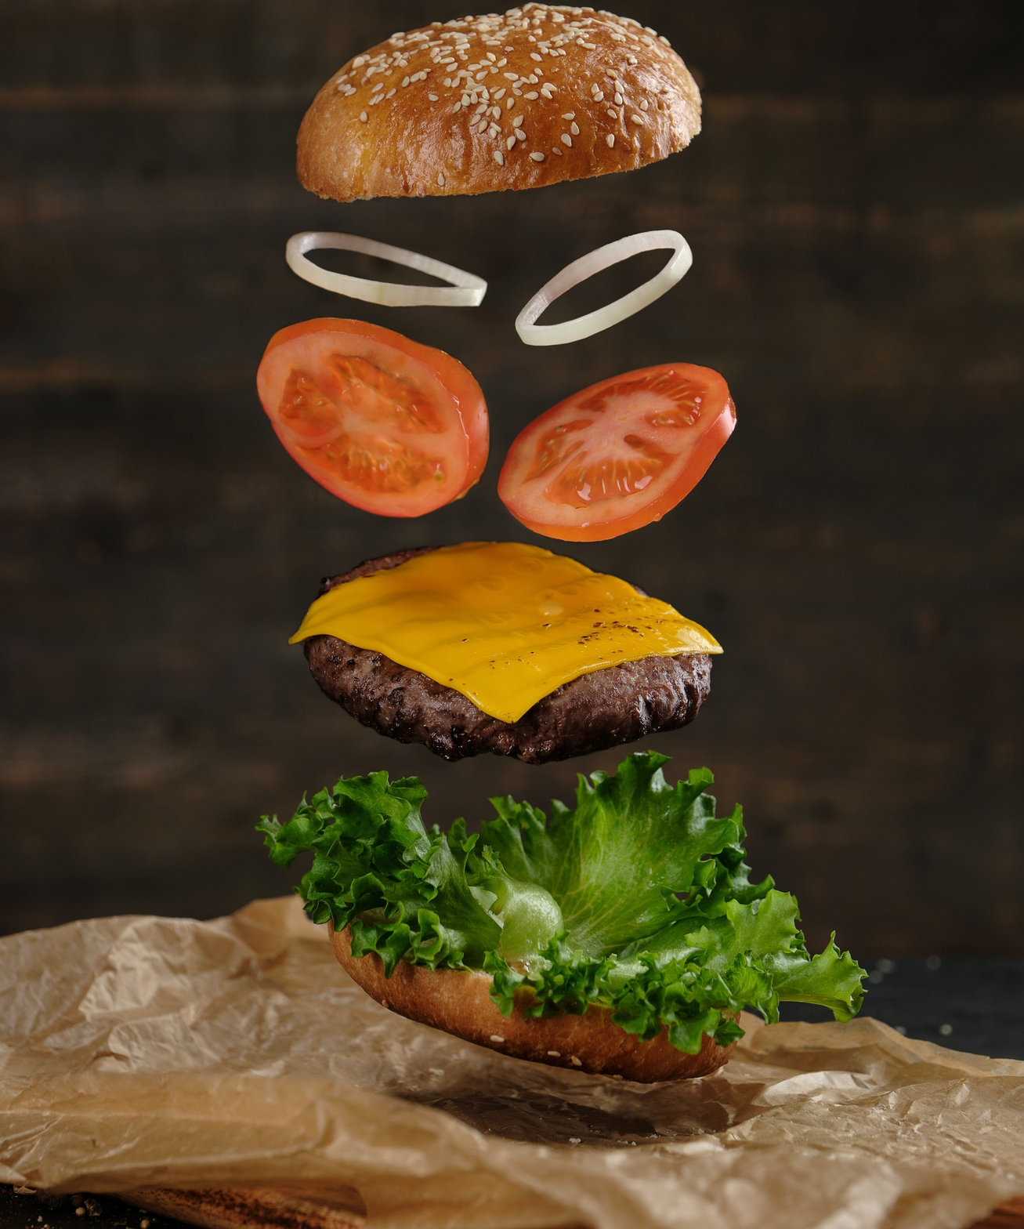
Burger Shop Premium Member Optimization
Members:
Mike Rocchio
Curtis Jensen

Slide 2



Introduction
Optimize premium membership pricing
Offer shorter wait times
Maximize burger shop revenue
The premium service provides the benefit of shorter wait times by allowing members to order from a priority queue.
The goal is setting the price to maximize overall revenue for the burger shop through subscription fees.
Determine the optimal price for the premium membership service to maximize revenue.
This presentation will cover the methodology and results of optimizing the premium membership pricing for a burger shop to maximize revenue by offering shorter wait times.

Slide 3


Input Data Overview
Menu dataset
Customer dataset
Includes item details like pricing, profitability, popularity
Includes customer subscription status and price tolerance
The provided datasets contain crucial information to model customer behavior and sales.

Slide 4
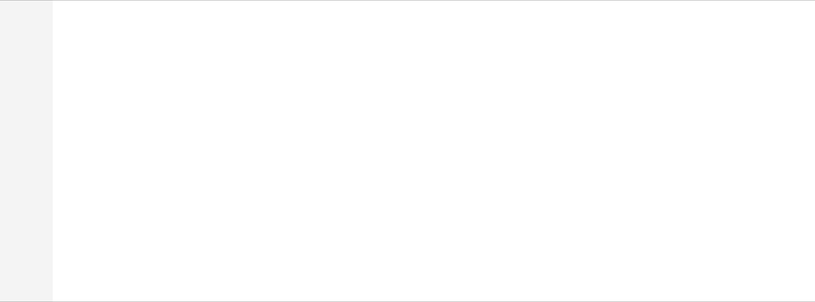
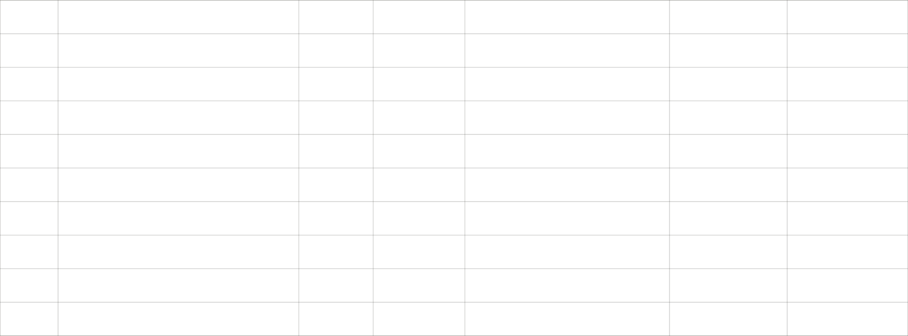
Restaurant's Menu
ID
Item
Price
Margin
Gross Profit Per Item
Popularity
Prep_Time
1
847 Burger Half-Pound
$8.00
70%
$5.60
5
0.5
2
847 Burger Full-Pound
$10.00
70%
$7.00
4
1
3
Milkshake Small
$5.00
80%
$4.00
2
1.5
4
Milkshake Large
$7.00
80%
$5.60
3
2
5
Drink Small
$3.00
90%
$2.70
3
0.5
6
Drink Large
$4.00
90%
$3.60
4
0.75
7
Fries Small
$4.00
70%
$2.80
5
0.5
8
Fries Large
$7.00
70%
$4.90
3
1
9
Ice Cream
$9.00
85%
$7.65
1
2
10
Peanuts
$3.00
80%
$2.40
2
0.25

Slide 5



Simulation Design
Customer arrivals
Order processing
Queue management
Customer behavior
Customers arrive based on a predefined average arrival rate
Orders are processed based on preparation times from the menu dataset. So each Datapoint has a customer order.
Regular and premium queues have different tolerances for waiting times
Customer decisions are influenced by price tolerance and premium subscription price
The simulation incorporates customer arrivals, order processing, queue management, and customer behavior to optimize the premium subscription price.

Slide 6
Simulation Data
index | customer_id | is_subscriber | is_impatient | queue_name | day | arrival_time | num_items_ordered | item1 | item2 | item3 | item4 | item5 | item6 | item7 | departure_time | action | profit | wait_time
0 | 522 | TRUE | TRUE | premium_queue | 1 | 1.020060287 | 2 | 2 | 7 | 0 | 0 | 0 | 0 | 0 | 2.520060287 | served | 9.8 | 1.5
1 | 303 | TRUE | FALSE | premium_queue | 1 | 1.341684351 | 3 | 1 | 4 | 1 | 0 | 0 | 0 | 0 | 5.020060287 | served | 16.8 | 3.678375936
2 | 723 | TRUE | FALSE | premium_queue | 1 | 6.667505509 | 3 | 1 | 2 | 3 | 0 | 0 | 0 | 0 |  | balked | 16.6
3 | 472 | TRUE | FALSE | premium_queue | 1 | 3.568972451 | 3 | 1 | 2 | 6 | 0 | 0 | 0 | 0 | 7.270060287 | served | 16.2 | 3.701087836
4 | 370 | TRUE | TRUE | premium_queue | 1 | 7.886835081 | 2 | 1 | 2 | 0 | 0 | 0 | 0 | 0 |  | balked | 12.6
172773 | 423 | TRUE | FALSE | premium_queue | 365 | 468.1442148 | 1 | 3 | 0 | 0 | 0 | 0 | 0 | 0 | 474.5784494 | served | 4 | 6.434234649
172774 | 577 | TRUE | TRUE | premium_queue | 365 | 475.2674155 | 3 | 2 | 1 | 1 | 0 | 0 | 0 | 0 |  | balked | 18.2
172775 | 285 | TRUE | FALSE | premium_queue | 365 | 468.2897081 | 1 | 3 | 0 | 0 | 0 | 0 | 0 | 0 | 476.0784494 | served | 4 | 7.788741273
172776 | 924 | TRUE | FALSE | premium_queue | 365 | 472.6961534 | 3 | 2 | 7 | 1 | 0 | 0 | 0 | 0 | 478.0784494 | served | 15.4 | 5.382295995
172777 | 428 | TRUE | TRUE | premium_queue | 365 | 474.6792758 | 3 | 1 | 7 | 7 | 0 | 0 | 0 | 0 | 478.6792758 | served | 11.2 | 4
This was quite a large dataset to generate, we used an c6a 48 X-large AWS Ec2 instance to generate the data.

Slide 7
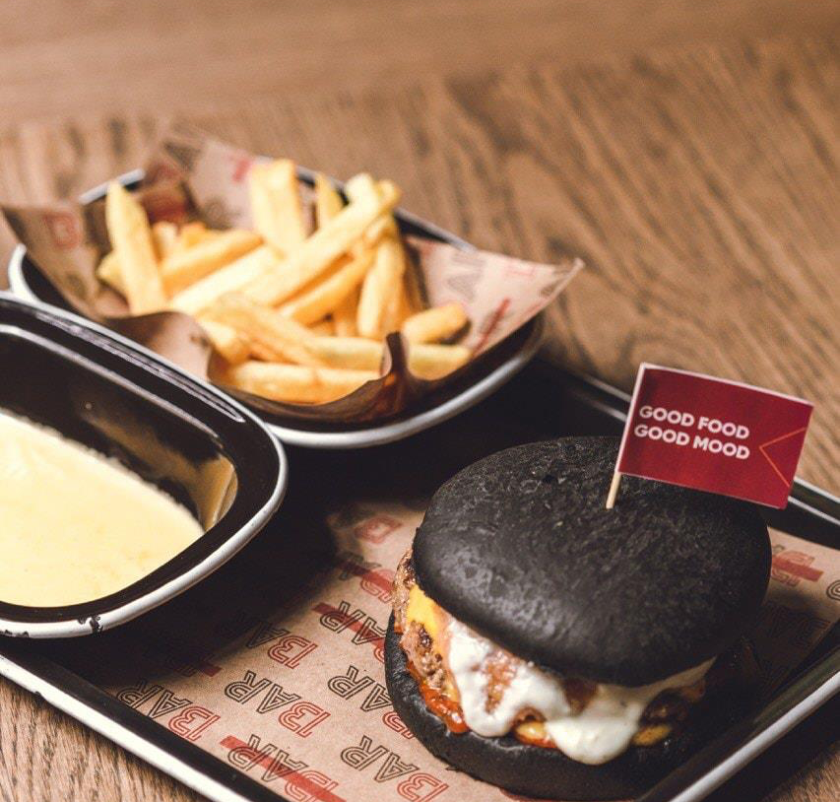
Optimization Goal
The goal is to find the optimal price for the premium burger shop subscription service that maximizes total profit.
This involves balancing the revenue from subscription fees against maintaining reasonable wait times and service levels to satisfy customers.
The optimal price should attract customers to subscribe while generating maximal recurring revenue for the shop.

Slide 8
Results & Analysis
Identified Optimal price of $11.60
Simulation analyzed profit distribution, wait times, order patterns, and subscriber behavior to find optimal price
Analyzed profit distribution
Assessed financial performance of menu items and customer choices impact on profit
Studied wait time distribution
Evaluated service efficiency and premium subscription's effect on reducing wait times
Examined order patterns
Gained insights into customer ordering behavior to aid inventory and staffing
Compared subscriber vs. non-subscriber counts
Assessed popularity and penetration of premium subscription service

Slide 9
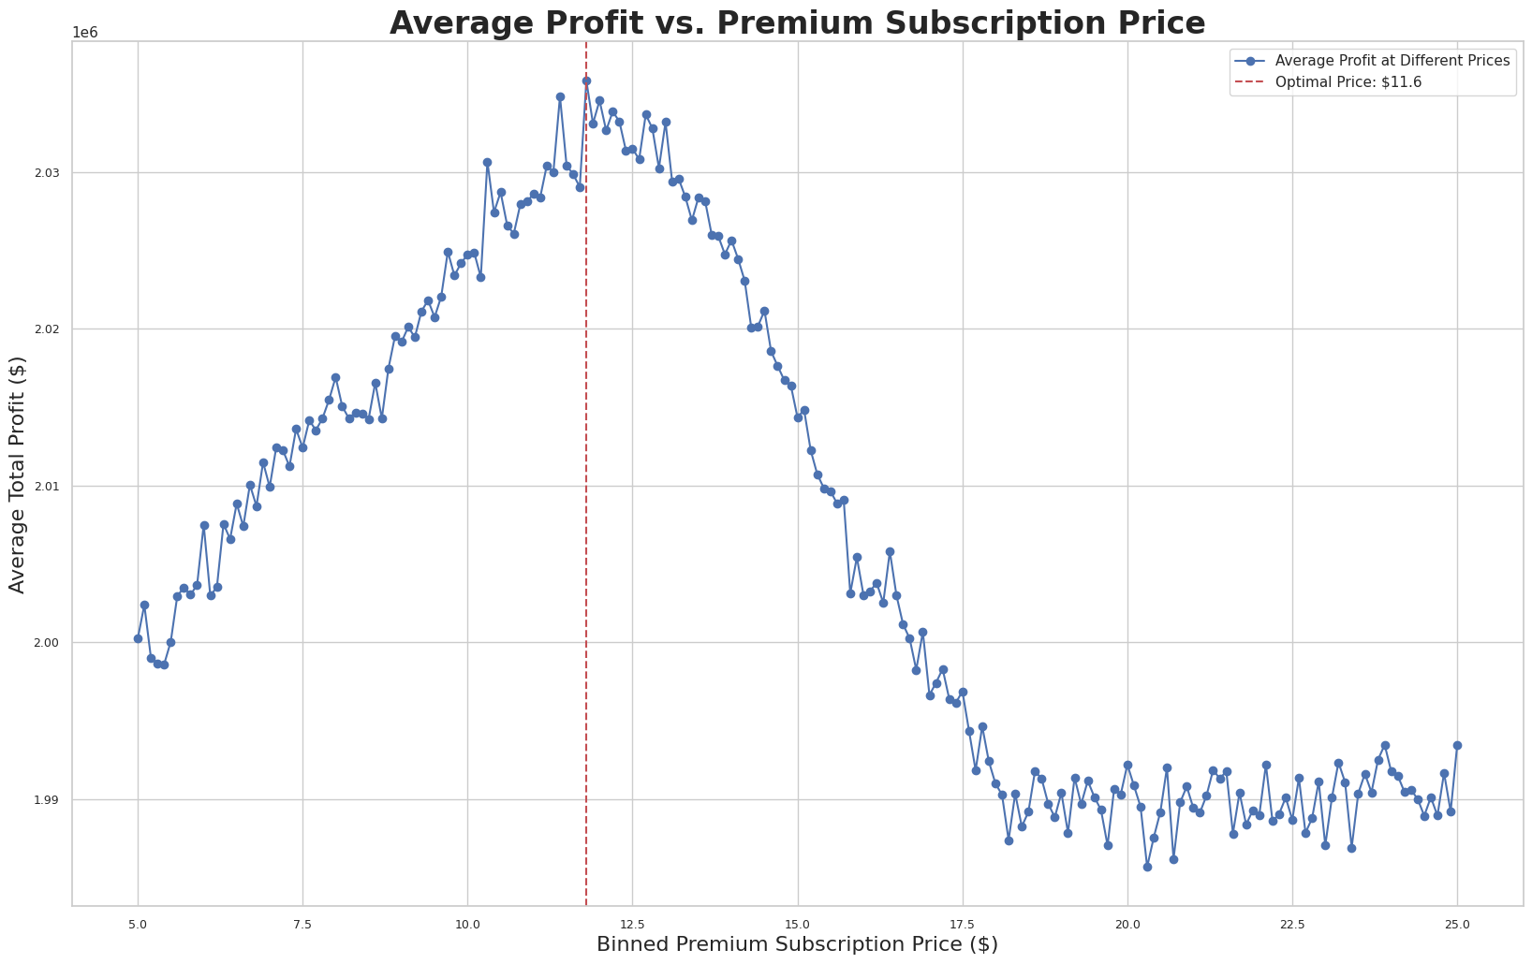
Optimization by Price

Slide 10
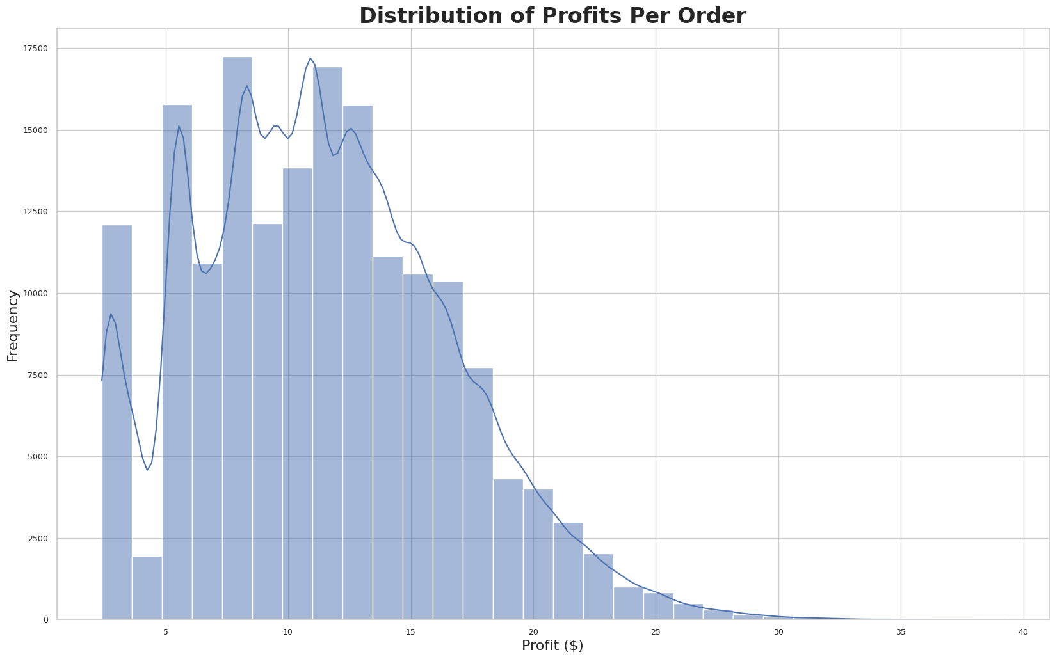
Order Profits
• Explanation : This histogram displays the distribution of wait times experienced by customers.
• Importance : The wait time is a significant factor in customer satisfaction. This graph helps in understanding how efficiently the shop is serving its customers. Long wait times can lead to customer dissatisfaction and potential loss of business. Analyzing this distribution helps in identifying bottlenecks in the service process and the effectiveness of the premium subscription in reducing wait times.

Slide 11
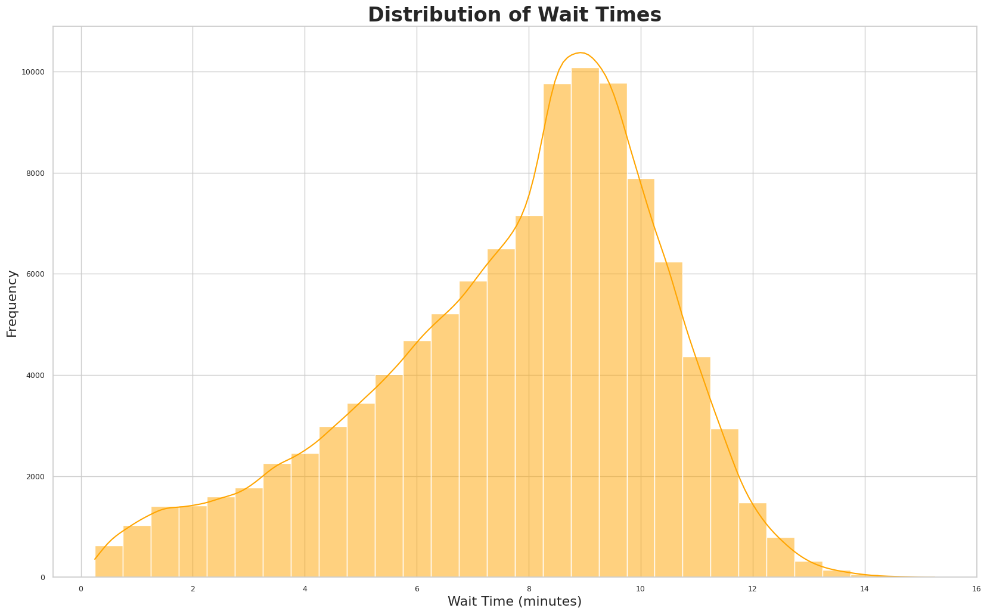
Wait Times
• Explanation : This histogram displays the distribution of wait times experienced by customers
• Importance : The wait time is a significant factor in customer satisfaction. This graph helps in understanding how efficiently the shop is serving its customers. Long wait times can lead to customer dissatisfaction and potential loss of business. Analyzing this distribution helps in identifying bottlenecks in the service process and the effectiveness of the premium subscription in reducing wait times.

Slide 12
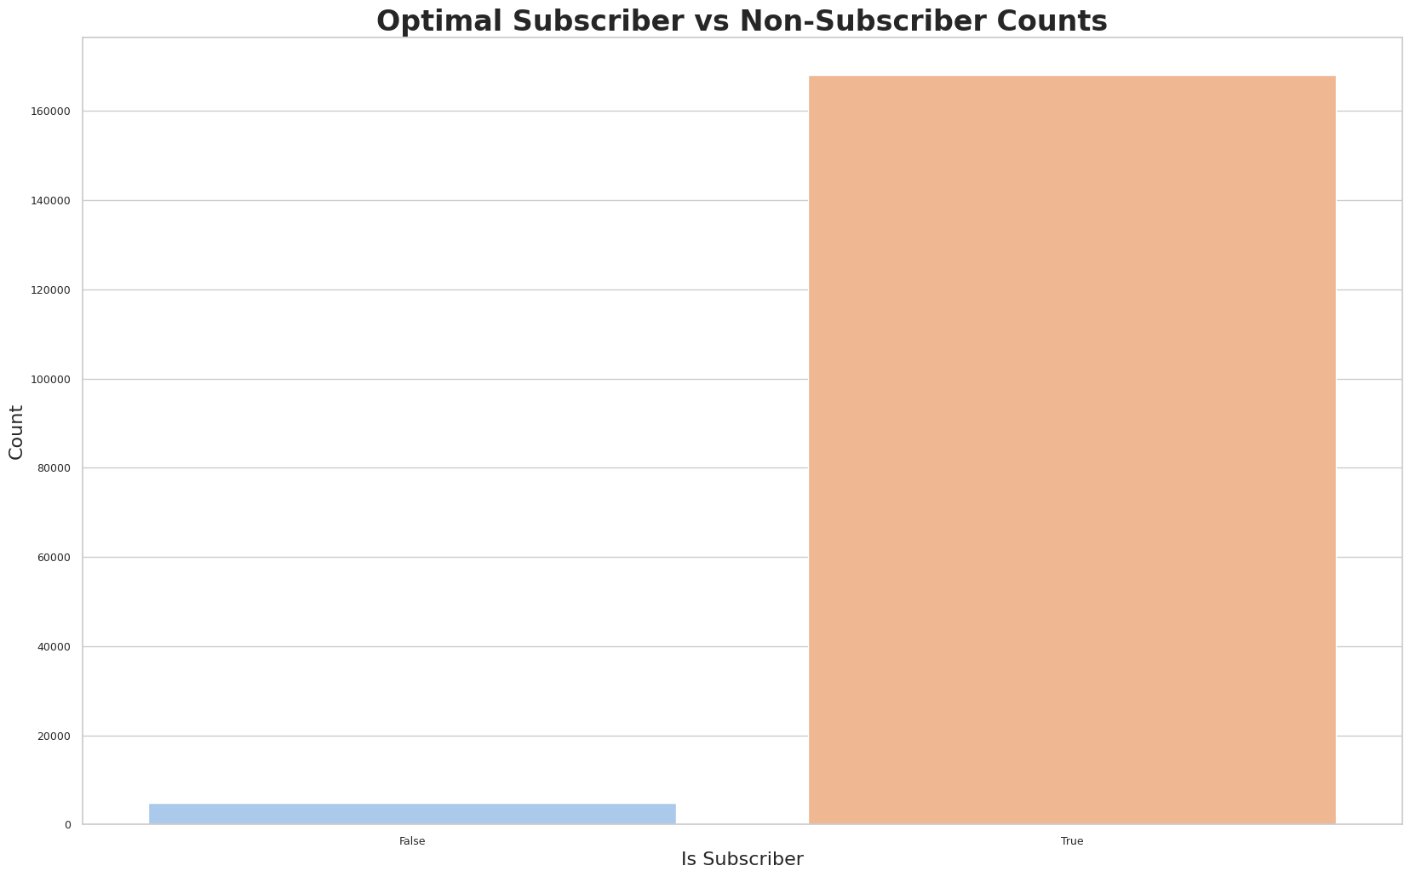
Subscriber Count
• Explanation : This bar chart compares the number of customers who are subscribers to the premium service against those who are not.
• Importance : This graph is important for assessing the popularity and penetration of the premium subscription service. A high number of subscribers may indicate a successful premium service, while a low number might suggest a need for re-evaluation of the service’s value proposition. This insight is crucial for strategic decisions regarding marketing, pricing of the subscription, and enhancing the service to attract more subscribers.

Slide 13
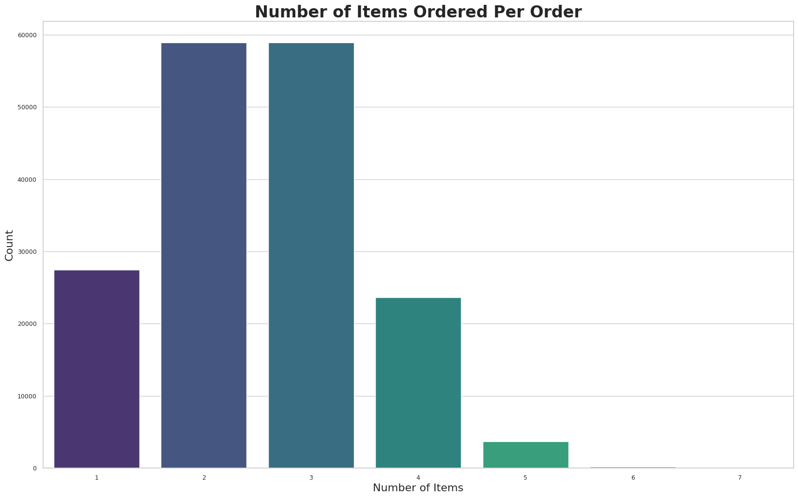
Order Count
• Explanation : This bar chart shows the frequency of different quantities of items ordered per transaction. It gives a clear view of how many items are typically ordered in one go.
• Importance : This graph provides insights into customer ordering behavior. Under- standing common ordering patterns is essential for inventory management, staffing requirements, and preparing for peak times. It can also aid in tailoring marketing strategies and promotions to encourage higher-order quantities.

